Slide 1

DBS Final Report
iDBS summer intern
Johnny Chen

Slide 2
INDEX
01
What I’ve learned?
02
Something interesting
.

Slide 3
01
What I’ve learned ?

Slide 4
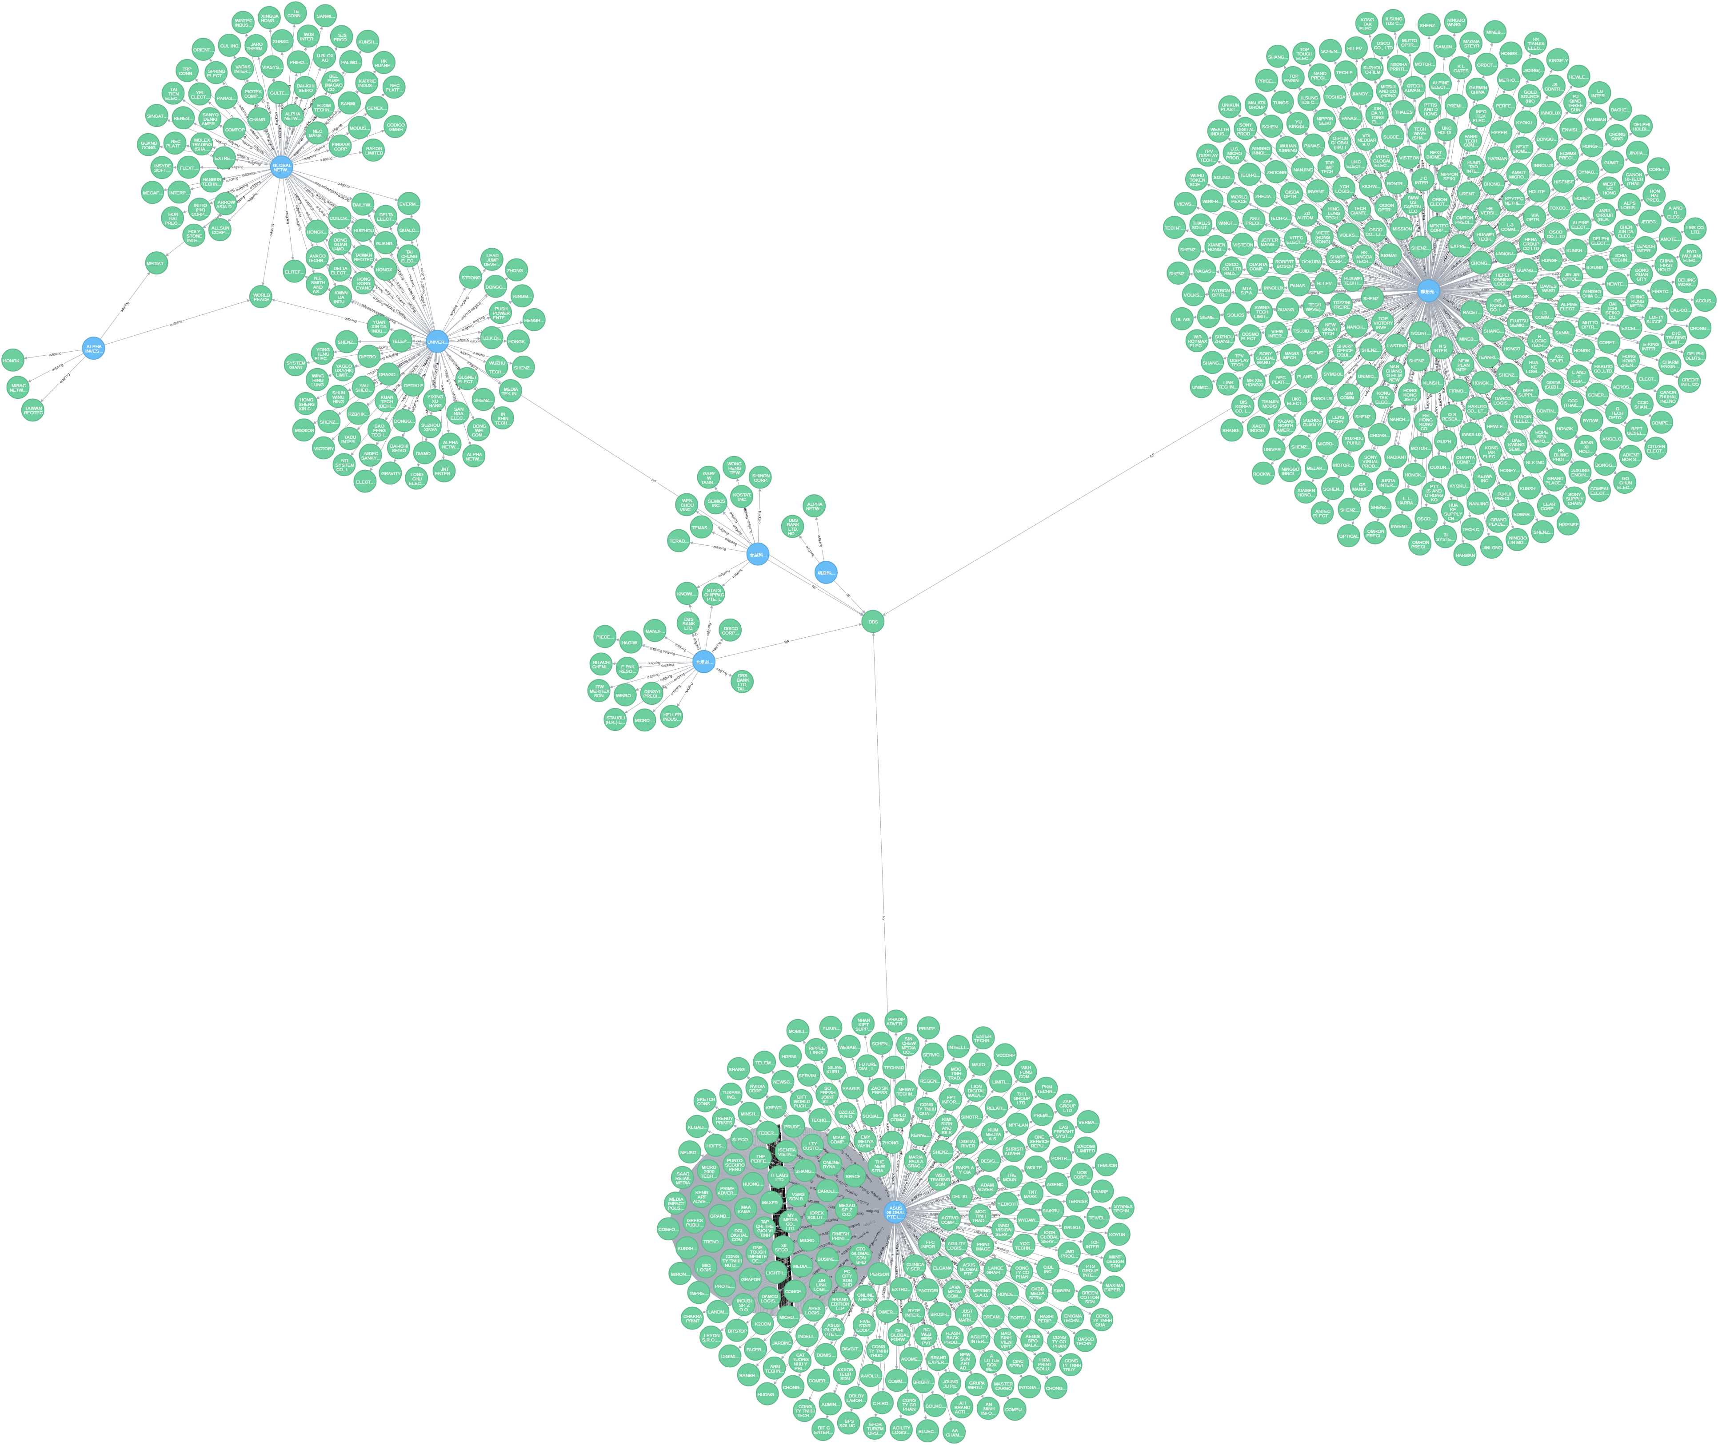
What I’ve learned ?
01
Lantern Project
CIF
Processing flow
Data migration
ACH
Processing flow
02
Neo4j
Building money flow and detecting the potential customers

Slide 5
02
Something interesting!

Slide 6
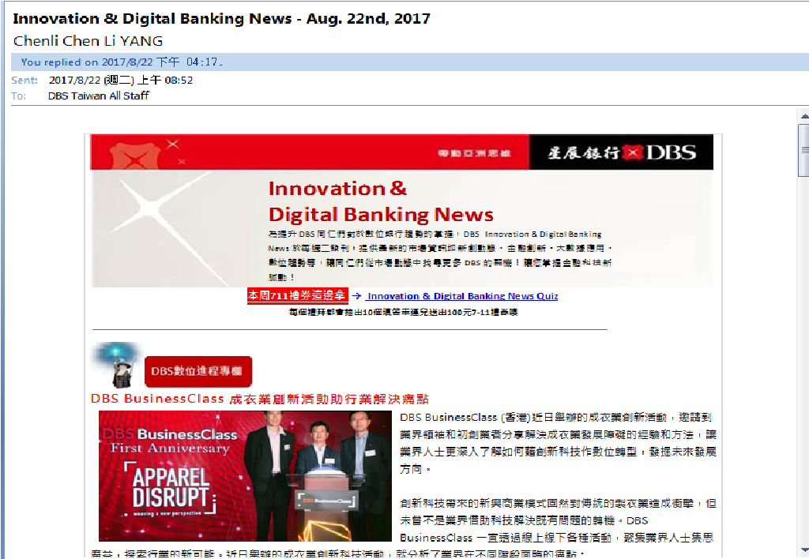
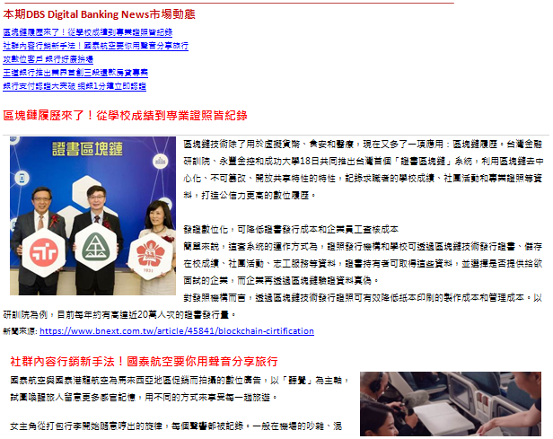
Innovation & Digital Banking News

Slide 7
2.5~3
hrs

Slide 8
1~1.5
hrs

Slide 9

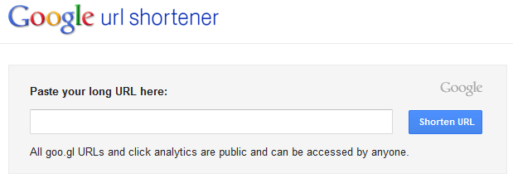












Working Flow
Collecting Data
Inserting data
Wrap to an email
Insert background images
Insert content (title, URL, content) with default format
Automatically Manipulate Outlook
add E-mail title
add recipients

Slide 10
News selecting flow
新聞標題篩選
Google關鍵字
搜尋新聞
數位
支付
AI
Fintech
Bitcoin
比特幣
NFC
區塊鏈
Block chain
數位金融OR
行動支付OR
第三方支付OR
比特幣OR
區塊鏈OR
金融科技
News
selecting
rules
5
pieces
70%
Random
柏克萊研發AI加持比特幣新技術，追蹤人口販賣和性交易犯罪

Slide 11


The “POSSIBLE” improvements
More innovation
Saving time

Slide 12
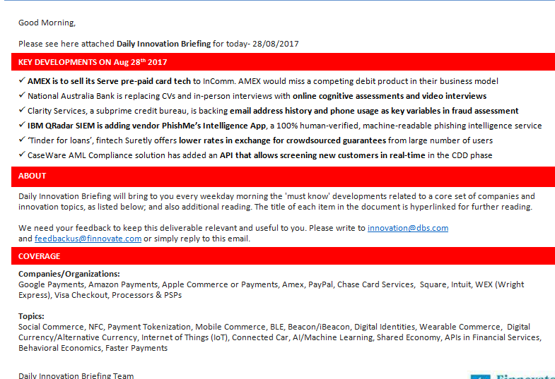
Other Applications
DBS- Innovation Briefing

Slide 13
Demo!

Slide 14
2017
THANKS VERY MUCH

